Slide 1
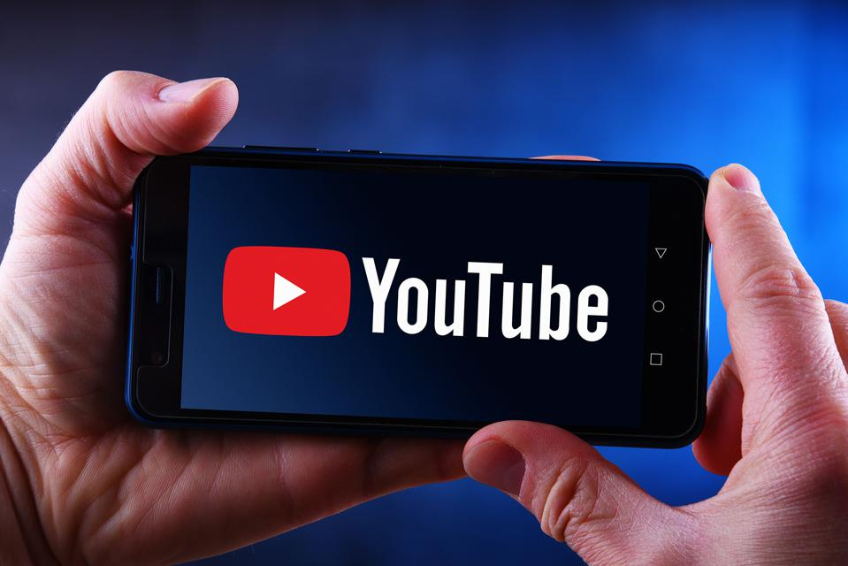
There are more than 1.9 billion users logged in to YouTube every single month who watch over a billion hours of video every day. Every minute, creators upload 300 hours of video to the platform.
YouTube to take advantage of the power of artificial intelligence (AI) to help operations. Here are a few ways YouTube, owned by Google, uses artificial intelligence today.
1.9 억 명의 유저가 매 월 YouTube 에 접속하며,
매 분마다 300 시간 가량의 비디오가 업로드 된다.
YouTube 인공지능(AI)의 이점을 활용해 플랫폼을 운영을 한다. 구글이 오늘날 인공지능을 사용하는 몇 가지 방법을 소개하고자 한다.
출처: https://www.forbes.com/sites/bernardmarr/2019/08/23/the-amazing-ways-youtube-uses-artificial-intelligence-and-machine-learning/#2388766e5852

Slide 2
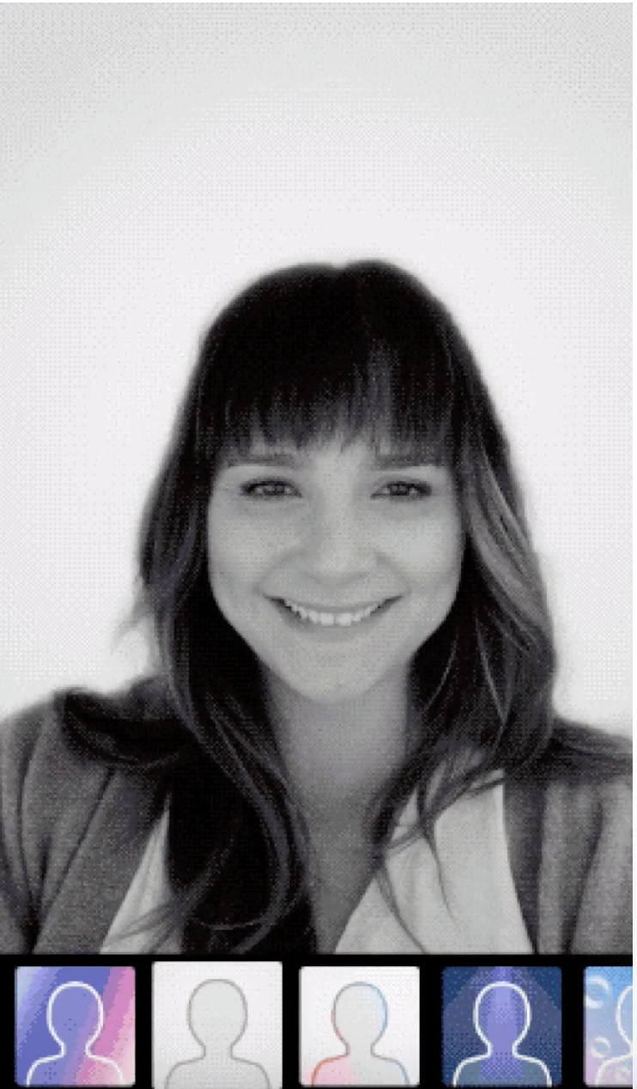
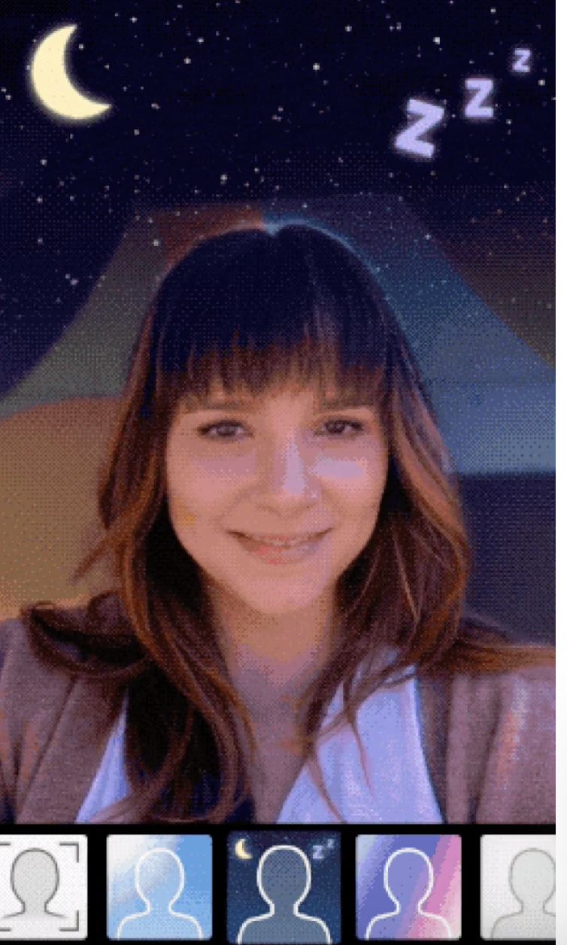
Automatically remove objectionable content
In the first quarter of this year, 8.3 million videos were removed from YouTube, and 76% were automatically identified and flagged by artificial intelligence classifiers.
-> 자동으로 부적절한 컨텐츠를 삭제하는데 활용
2019년도 1분기에는 8천 300만개의 비디오가 삭제되었는데, 이 중 76% 가 AI 에 의해 자동으로 검열 되었다.
New effects on videos
The researchers trained an algorithm with carefully labeled imagery that allowed the algorithm to learn patterns, and the result is a fast system that can keep up with video.
-> 비디오에 활용되는 새로운 효과
알고리즘이 패턴을 학습할 수 있도록 주의 깊게 라벨을 붙인
이미지로 알고리즘을 훈련시켰고, 그 결과 별도의 장비 없이
비디오의 배경을 바꿀 수 있는 효과를 만들어 내었다.

Slide 3
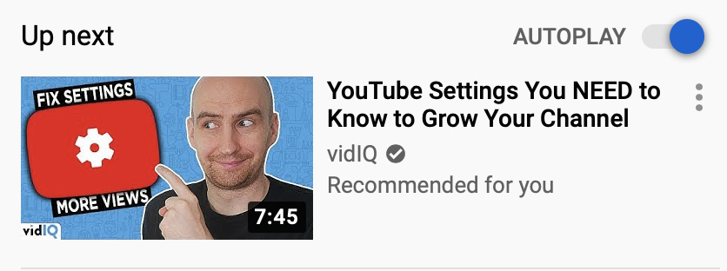
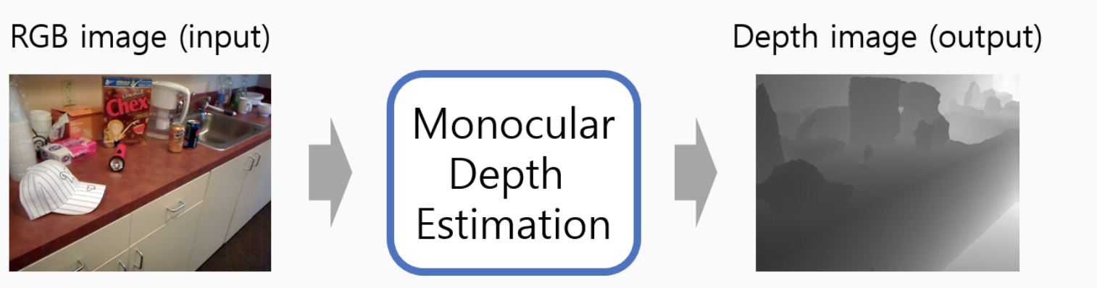
“Up Next” feature
It had to be able to handle real-time recommendations while new
data is constantly added by users. The solution they came up with
is a two-part system. The first is candidate generation, where the
algorithm assesses the YouTube history of the user. The second part is the ranking system that assigns a score to each video.
-> 다음에 재생될 목록 기능
AI가 실시간으로 추가되는 새로운 데이터들도 고려하며 다음 영상을 추천해낸다.
Training on depth prediction
With so much data, YouTube videos provide a fertile
training ground for artificial intelligence algorithms.
-> depth prediction 훈련
한장의 이미지로부터 영상의 픽셀 별 깊이(depth)를 추정하는 기술. semantic segmentation을 학습하듯 입력 영상의 패턴과 출력(depth)을 기계적으로 학습. 유튜브에 제공되는 수많은 데이터를 활영하며 딥러닝을 사용하여 이를 학습시킨다.

Slide 4
How Does the YouTube Algorithm Work?
“Up Next” feature
A brief history of the YouTube algorithm
2005-2012: View count (a.k.a. clicks)
For the first seven years, YouTube rewarded videos that got clicks, rather than the ones that kept users engaged. Obviously, this system had a tendency to show people a lot of clickbait: misleading titles and thumbnails proliferated.
-> 조회수 (클릭수) 를 기준으로 추천. 그러나 유저들이 많은 썸네일 낚시와 제목 낚시에 노출되었다.
2012: Watch time (a.k.a. view duration)
By prioritizing videos that hold attention throughout (as well as increasing the amount of time a user spends on the platform overall) Meanwhile, YouTube was also encouraging creators to stop fussing with algorithm optimization (i.e., making videos shorter to get a higher retention rate, or making them longer in order to rack up more watch time).
-> 실제 그 영상을 시청한 시간을 기준으로 추천. 이로 인해 크리에이터들의 알고리즘 최적화 소동 (재시청률을
높이기 위해여 영상을 더 짧게 만든다던가, 영상을 시청한 시간을 늘리기 위해 영상을 더 길게 만든다던가) 이
생김
출처: https://blog.hootsuite.com/how-the-youtube-algorithm-works/

Slide 5
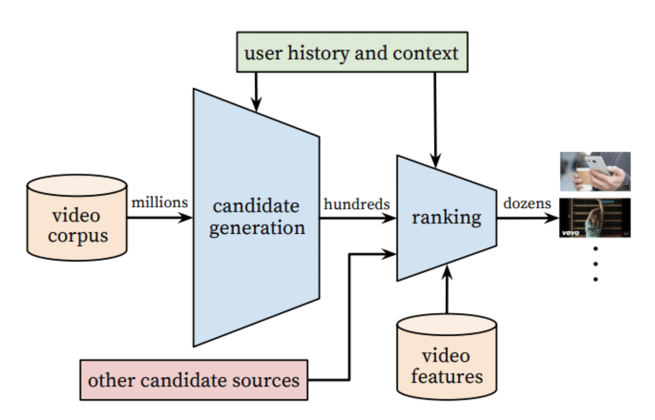
2016: Machine learning (a.k.a. the algorithm)
In 2016, YouTube released a whitepaper that made some waves. In it, product engineers described the role of deep neural networks and machine learning in the platform’s recommendation system.
-> 머신러닝 도입
Figure 2: Recommendation system architecture demonstrating the “funnel” where candidate videos are retrieved and ranked before presenting only a few to the user.

Slide 6
https://static.googleusercontent.com/media/research.google.com/en//pubs/archive/45530.pdf
(Source: Deep Neural Networks for YouTube Recommendations, 2016)
Of course, for all the impressive jargon, this whitepaper wasn’t a tell-all. You can read it, but even if you understand it (or get your smart friend to explain it to you), it’s not the equivalent of Coca-Cola’s secret recipe. (It’s more like if Coca-Cola announced that the reason their beverage is so tasty is because it undergoes a carbonation process and also there is sugar in it.)
At this point, we still don’t know that many details about what’s under the YouTube algorithm’s hood. But we do know that it tracks viewers’ perceived satisfaction to create an addictive, personalized stream of recommendations.
-> 전반적인 설명은 있는데 모든걸 말해주진 않는다.
Ex ) 코카-콜라의 비밀 레시피 ( 코카콜라가 음료수가 맛있는 이유를 carbonation process and also there is sugar in it.

